Slide 1
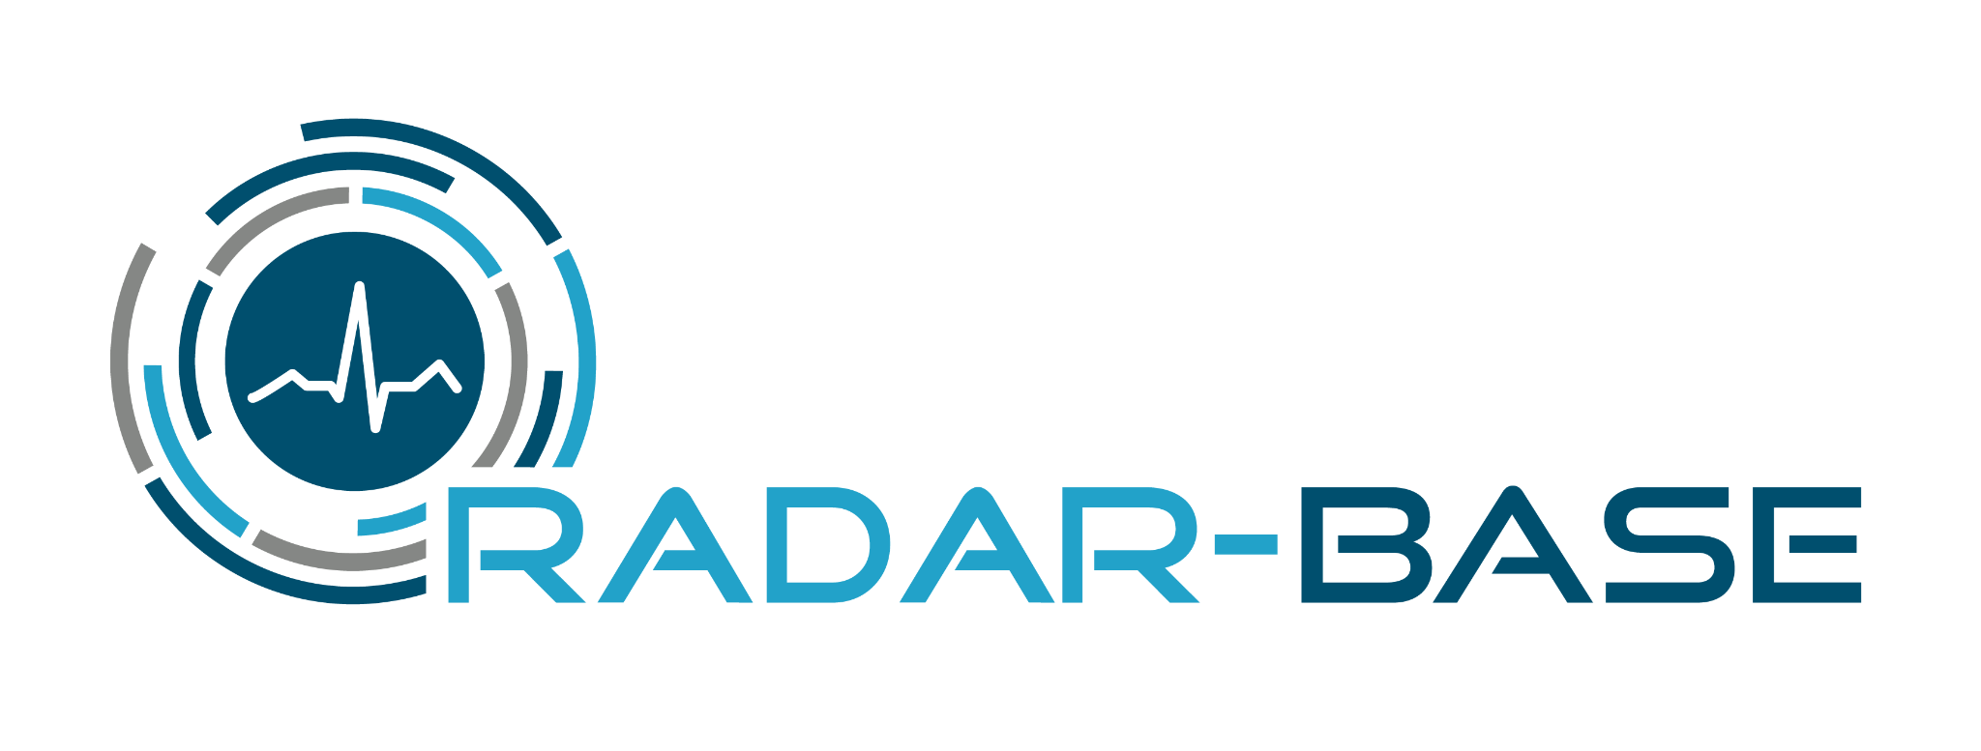

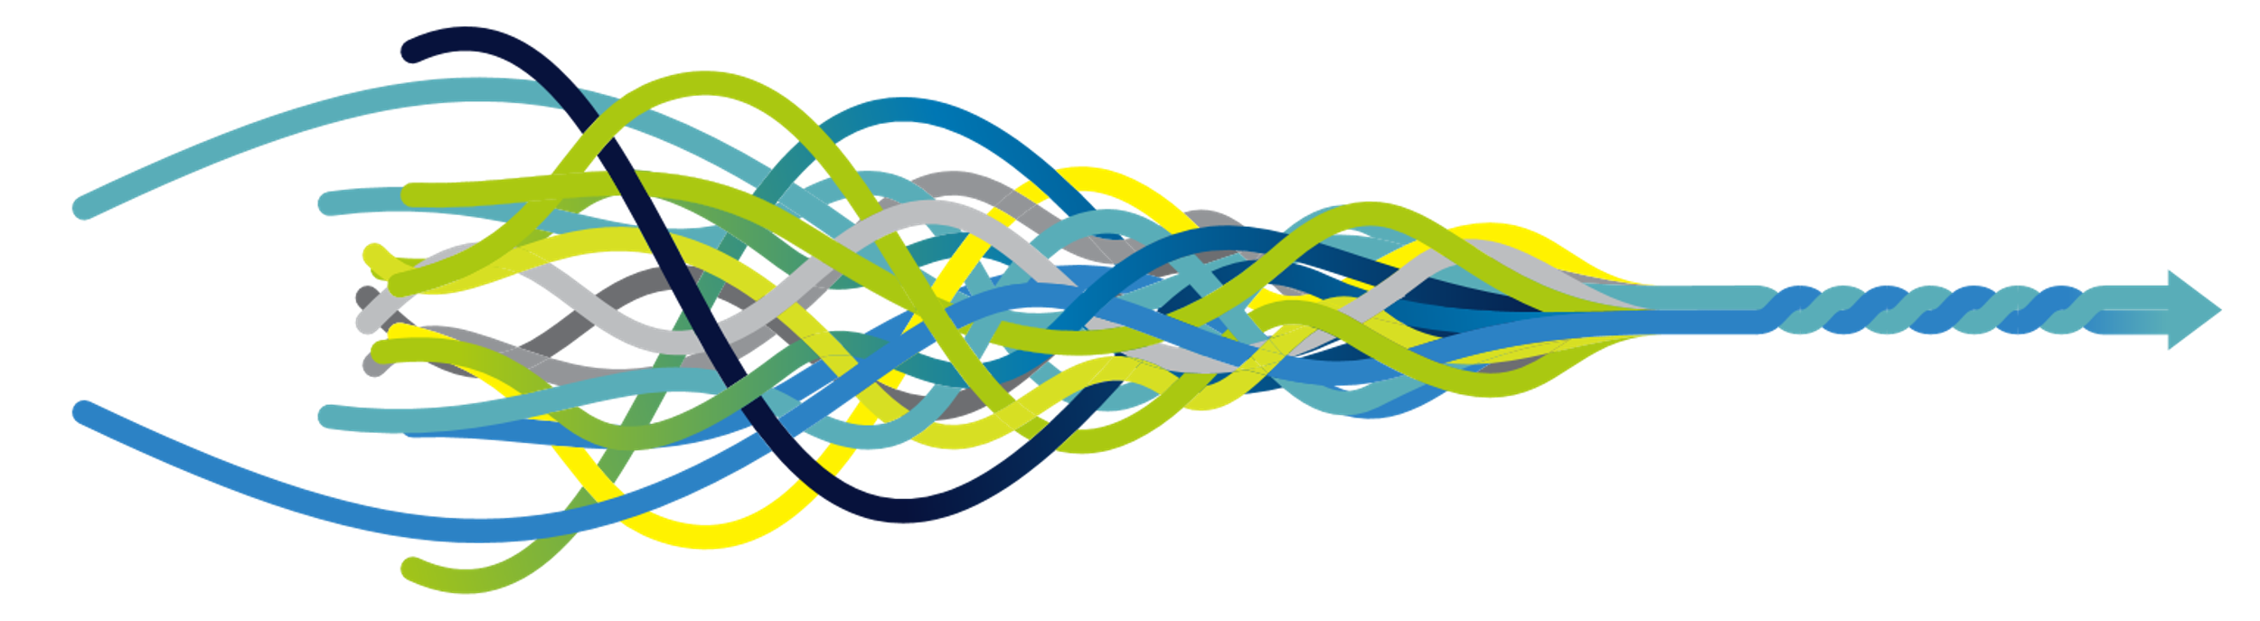
Remote Monitoring with the RADAR-base Platform
Amos Folarin
Maudsley BRC Mobile Health & Software Development Lead
Notes:
We've heard a lot about remote monitoring and the potential of this field. If you’ve ever struggled or wondered about how to go about setting up a remote monitoring study. I'd like to tell you a bit about our journey with RADAR-base

Slide 2
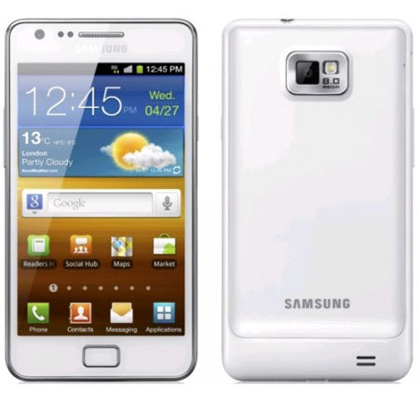
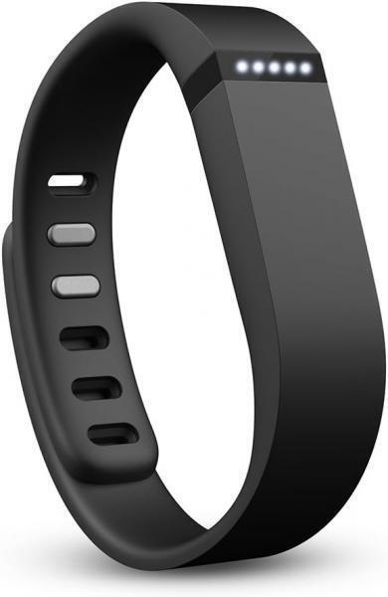
Mobile Health Interest Group Started in 2012
When we started, we were interested in novel covariates for Genome Wide Association Studies (GWAS) studies in mental health (e.g. sleep).
Back then the latest FitBit was the Fitbit Flex, and only sensed movement (IMU)
Phones were by then pretty smart (Galaxy S2/3, iPhone 4) but penetration in 2012 was 30-40% compared today over 91% *.
* https://www.statista.com/statistics/300398/smartphone-usage-in-the-united-kingdom/
Notes:
When we first started we were interested novel datas sources to complement genomic datasets the group was working on, clinical records were one and remote monitoring was another.
At the time, the consumer wearable marked was rather small, for example the FitBit Flex a simple IMU device containing an accelerometer and gyroscope. Sleep logging by tapping the device (one consequence was vibrations of pushing a shopping trolly would trigger sleep mode!)
Smart phones had been around for a while but were not nearly as pervasive as the are today.
Coming from Bioinformatics, a world of microarrays and genomic sequencing, into Mental Health, I was struck by emphasis on subjective rating scales (vs objectively measured markers), this I realized was primarily due to a barrier for measuring behaviour and other physiological and phenomenological traits directly.
It became apparent to me that the most likely tool for changing this would be the mobile phone in everyone's pocket, add to this wearables and a growing range of parameters I was motivated to see how this technology could be brought to bear in healthcare.

Slide 3

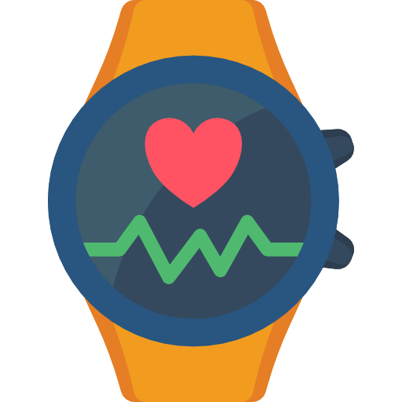

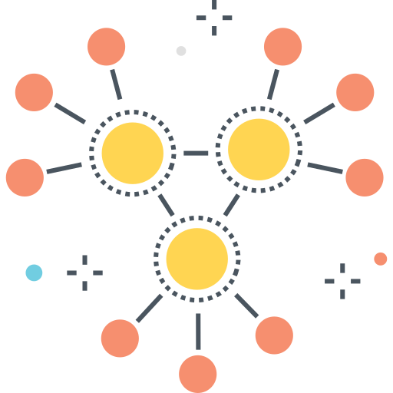
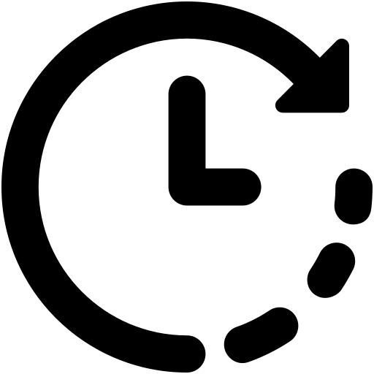



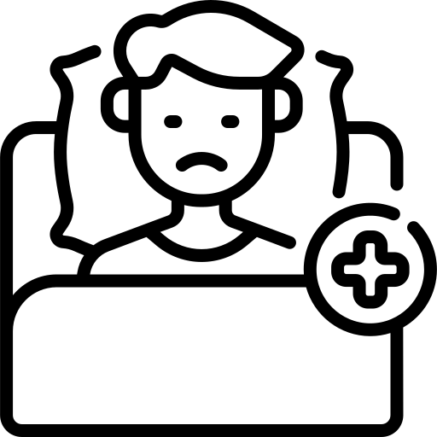
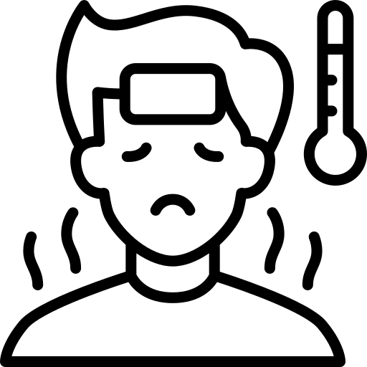
Motivations for Remote Monitoring
Decentralised Data Collection
~Real-time Processing
& Intervention
Paradigm inversion
Growing volume of passive data from phones & wearables e.g.
44% wearable ownership in USA*
Objective Data
Labelled Data
Big Passive Data
Monitoring recovery/decline
Diagnostic
Intervention
Training
AI & ML
Risk Assessment, Community Care, Self Management
Citizen Science
* Nagappan A, Krasniansky A, Knowles M
Patterns of Ownership and Usage of Wearable Devices in the United States, 2020-2022: Survey Study (2024)
J Med Internet Res 2024;26:e56504
doi: 10.2196/56504
Notes:
Our motivations then became how to use this new technology to
Decentralise data collection and enable Citizen Science. Take advantage of the sensing capabilities and growing ownership of wearable devices.
Scale up data collection. Using these devices to capture large volumes of valuable passive data from phone sensors and wearable devices.
Develop methods for using these datasets to train machine learning and artificial intelligence models to help understand but also to create novel therapies
Over the horizon we want to really see how these tools can be moved into clinical practice, inverting the paradigm of the patient going to the doctor when they ill, to the doctor being alerted to patients before or as soon as they are ill.
Improving i) Treatment, ii) self-management iii) economics of healthcare.
Many of these are echoed in the Darzi Report last year.
Shifting from hospital to community care
Changing from analogue to digital
Moving from treating sickness to preventing it

Slide 4
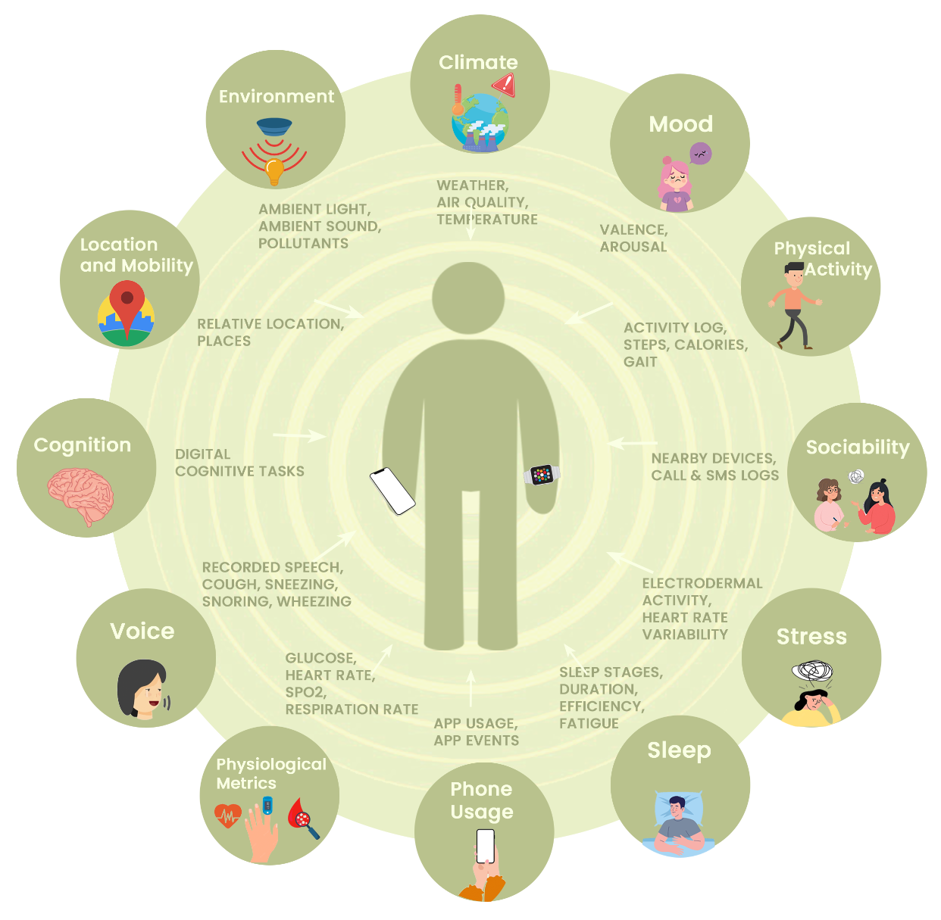
Growth of remote monitoring applications
Notes:
While our first interests we began with Sleep, we quickly realised a wide range of potential use cases existed, we expect this trend in sensing capabilities to continue to continue rise.
We have done many interesting things with these data types for example, using Mobility for measuring home stay and QoL, Bluetooth device as a proxy for Social Contact, Speech and Depression, Heart Rate for exacerbation in COPD

Slide 5
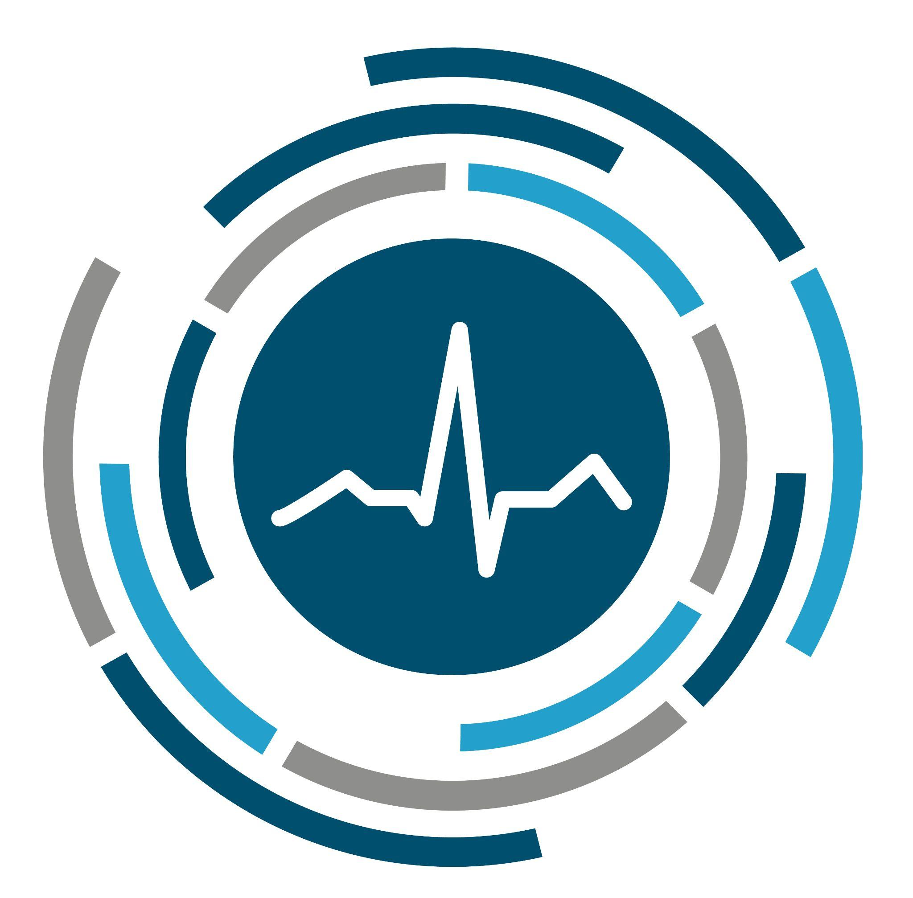
What is RADAR-base?
an open source platform for remote data collection
Notes:
So, onto a brief background about RADAR-base, the remote monitoring platform we built to collect our data

Slide 6

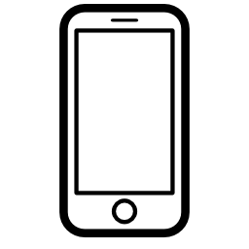
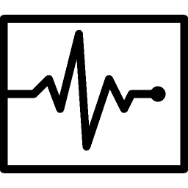



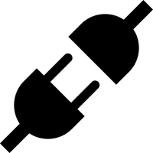
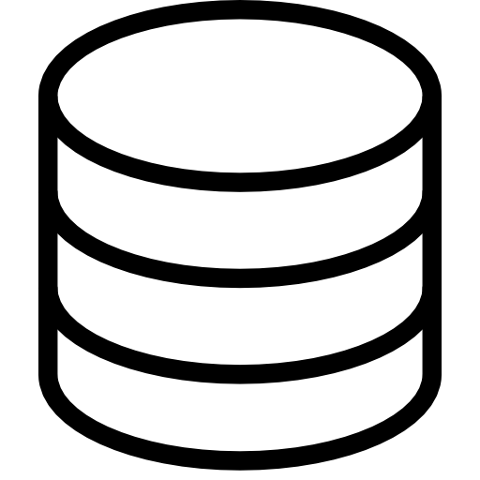
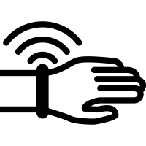
DATA PRODUCERS
…BUILD IT!
DATA CONSUMERS
Volume
PLATFORM
User Feedback & Intervention
Phone Sensors
and Questionnaires
Velocity
Clinical Applications
3rd Party Data APIs
Variety
Wearable SDKs
Research Datasets and APIs
Notes:
This slide is from back In 2015, it is a rough sketch of what we needed, we began a number of remote monitoring research studies in our group and found we needed a platform to collect the data from mobile phone sensors, wearables, and 3rd Party APIs. At the time there were few options available to us that would scale up to our needs.
A principle requirements of this platform was to handle data with high volume, velocity and variety and make this available to multiple types data consumers, initially for research datasets, user feedback, and clinical dashboards.
There are many challenges engineering this type of scale-out infrastructure. However, we were very fortunate that our work coincided with a spin-out from LinkedIn called Confluent, whose work around the Apache Kafka project, a scalable event data store and stream-processing platform, later formed a core aspect of RADAR-base.

Slide 7
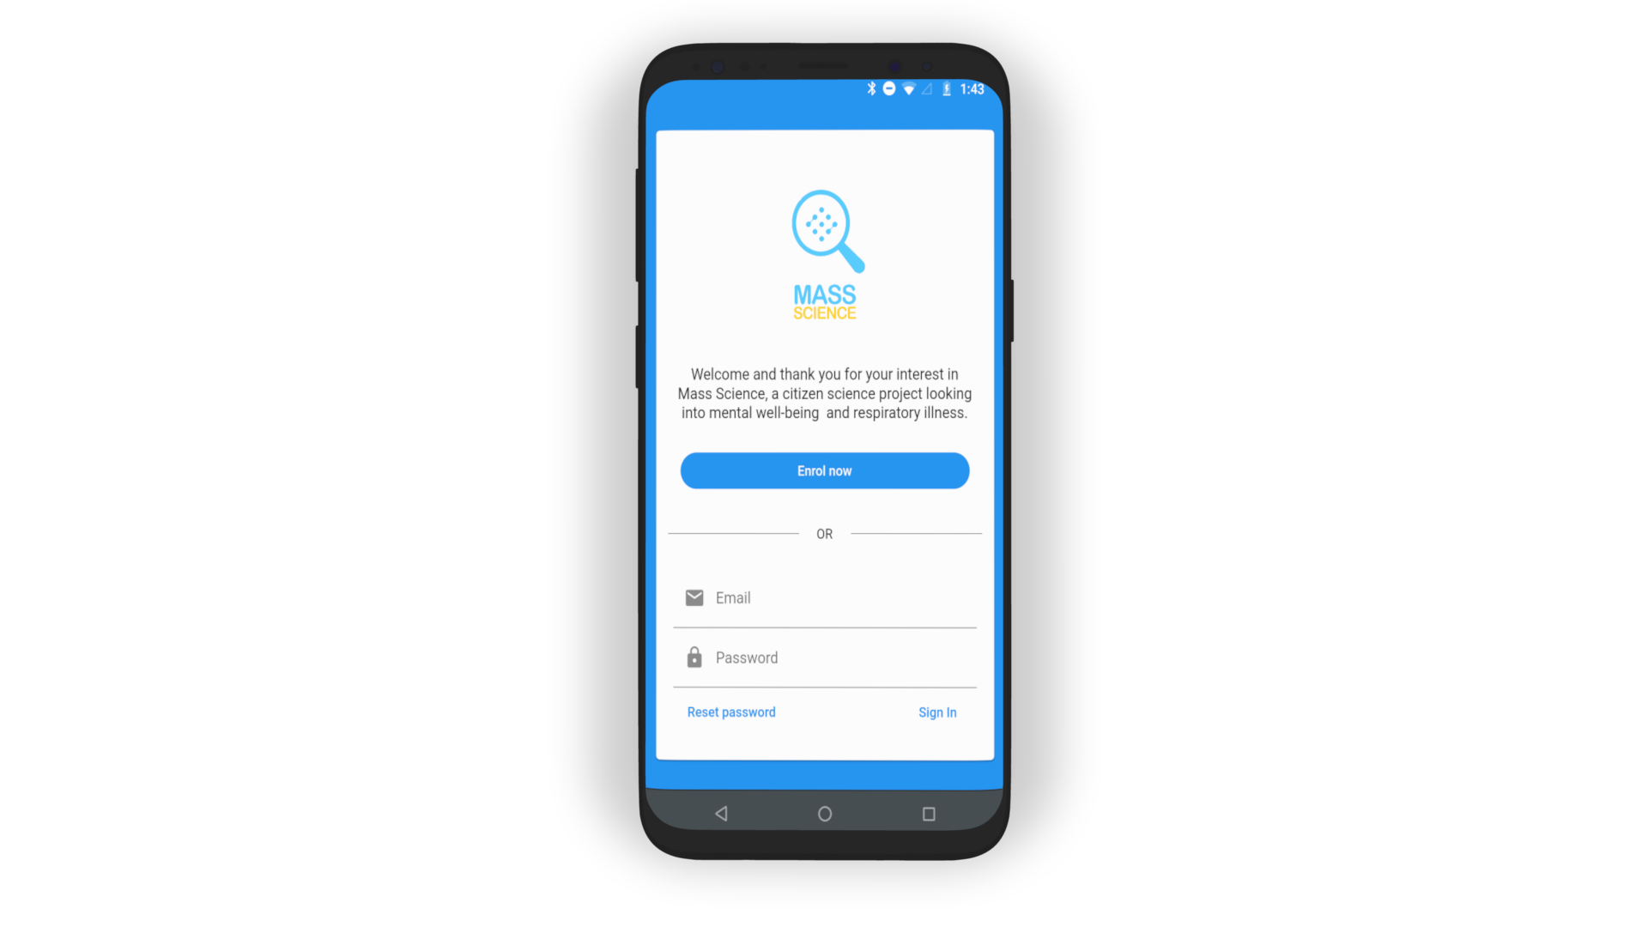
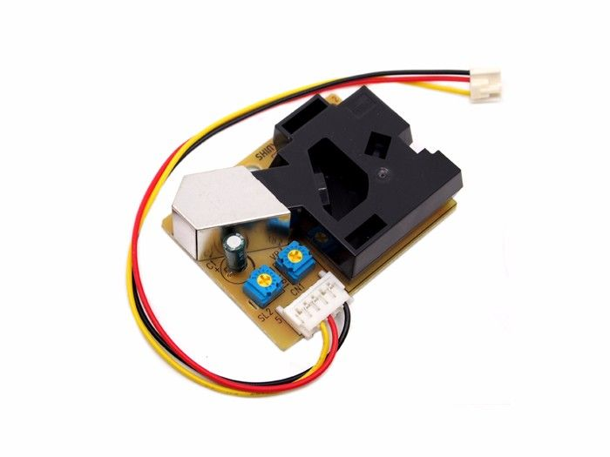
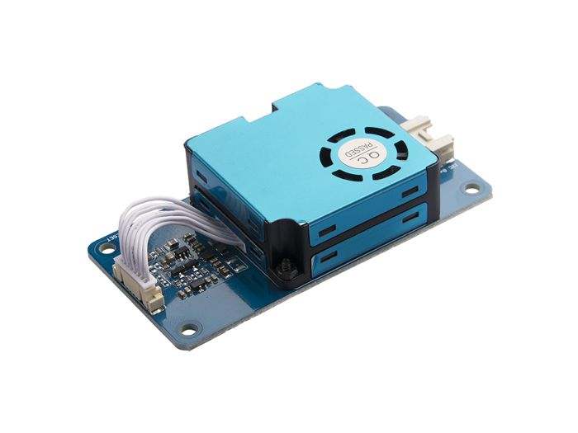
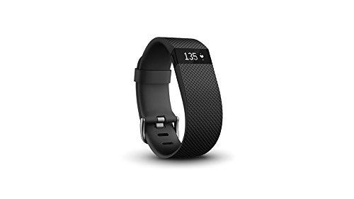
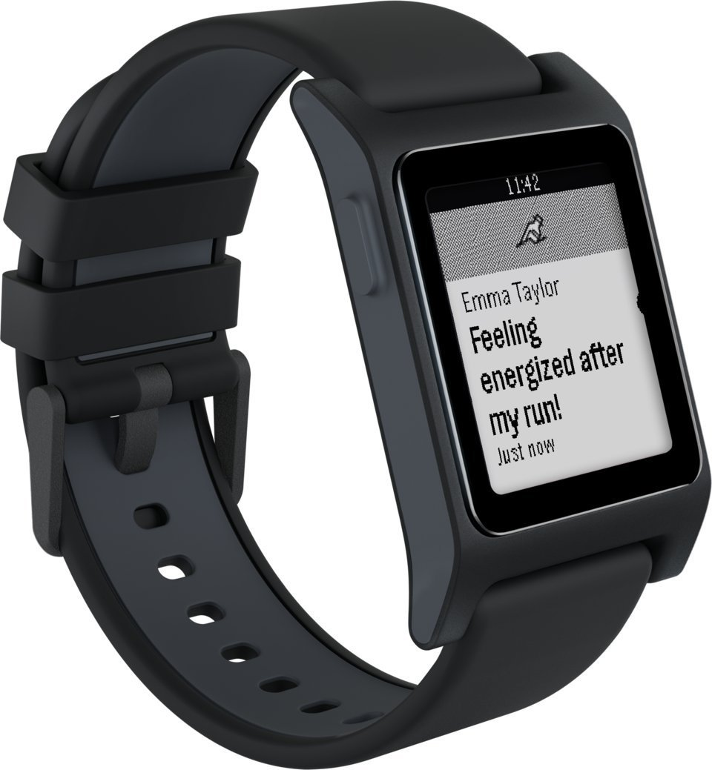
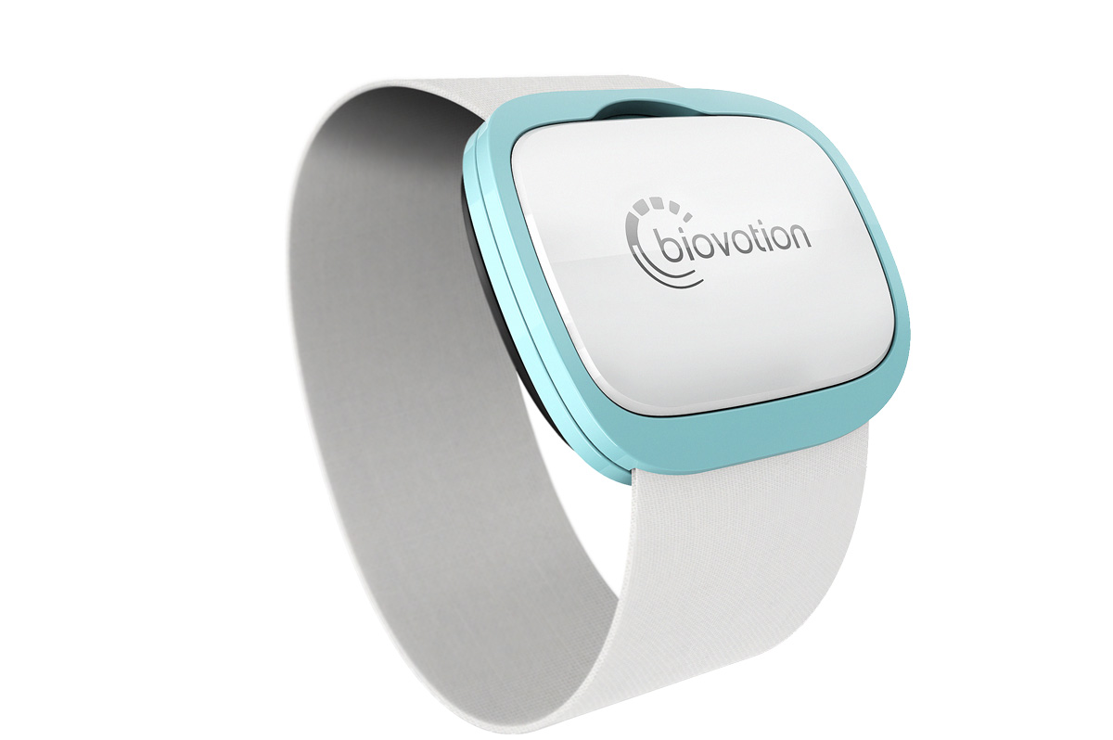
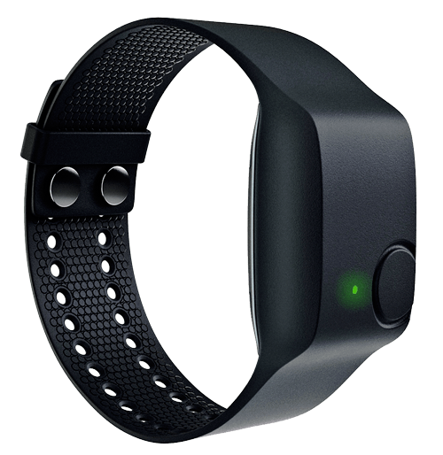
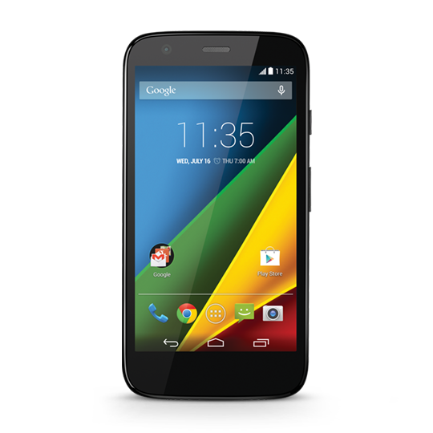
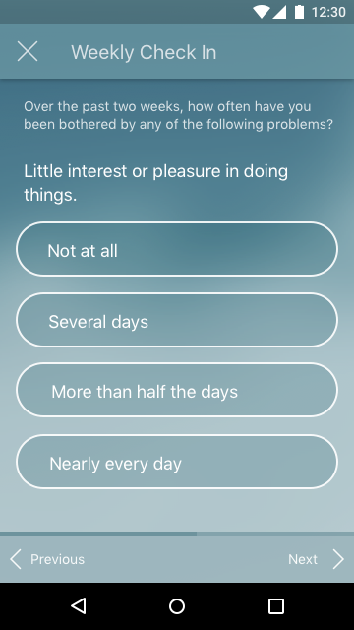
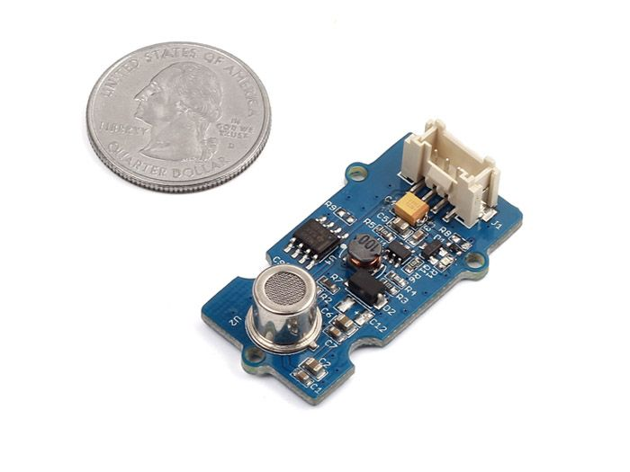
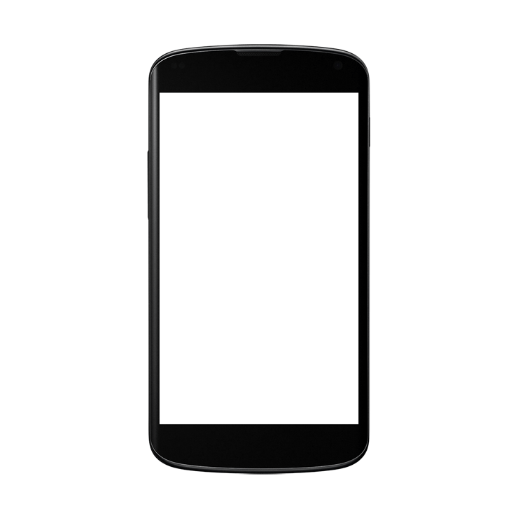
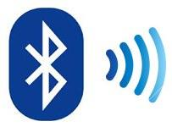
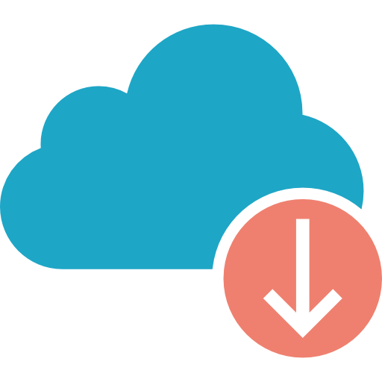
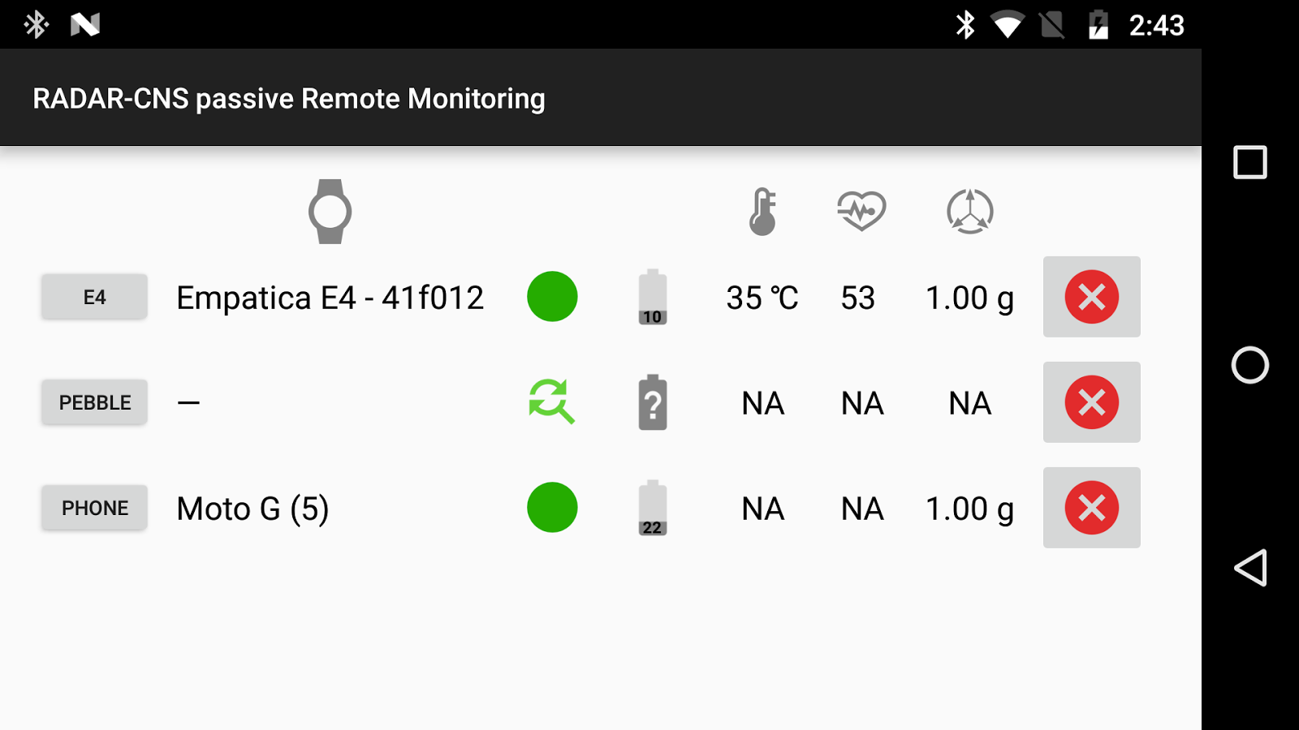
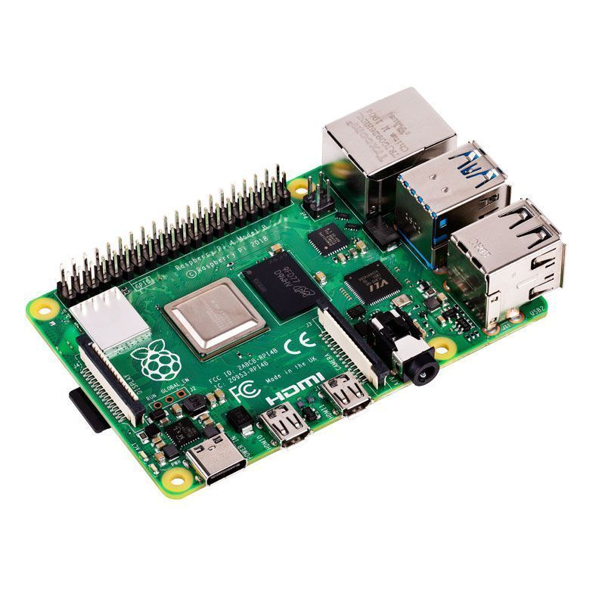
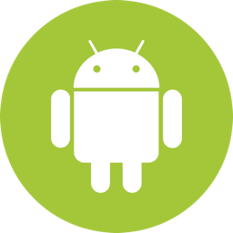
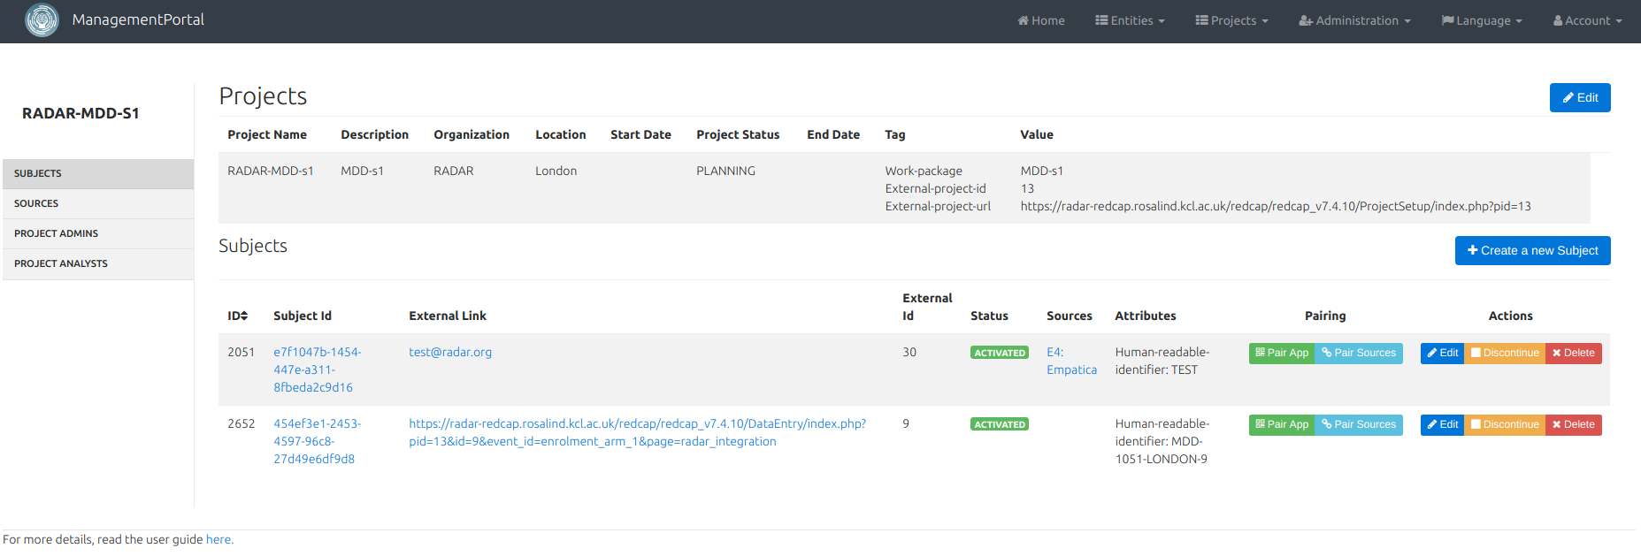
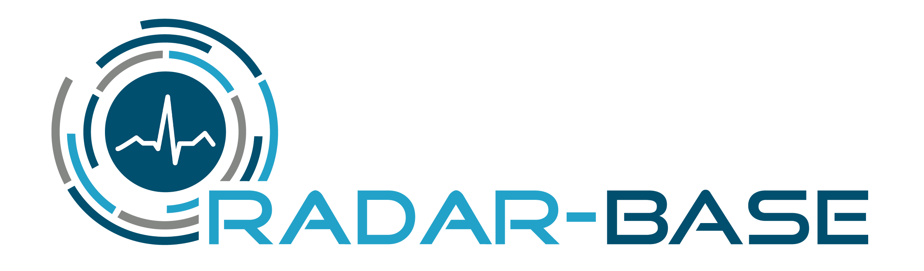

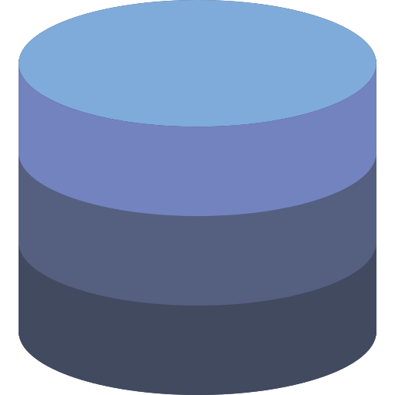
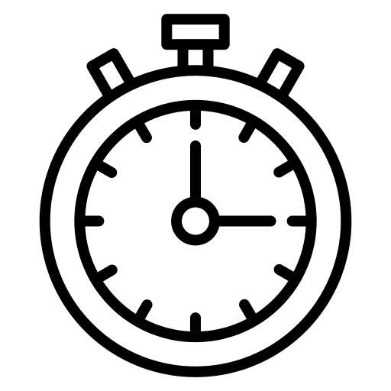
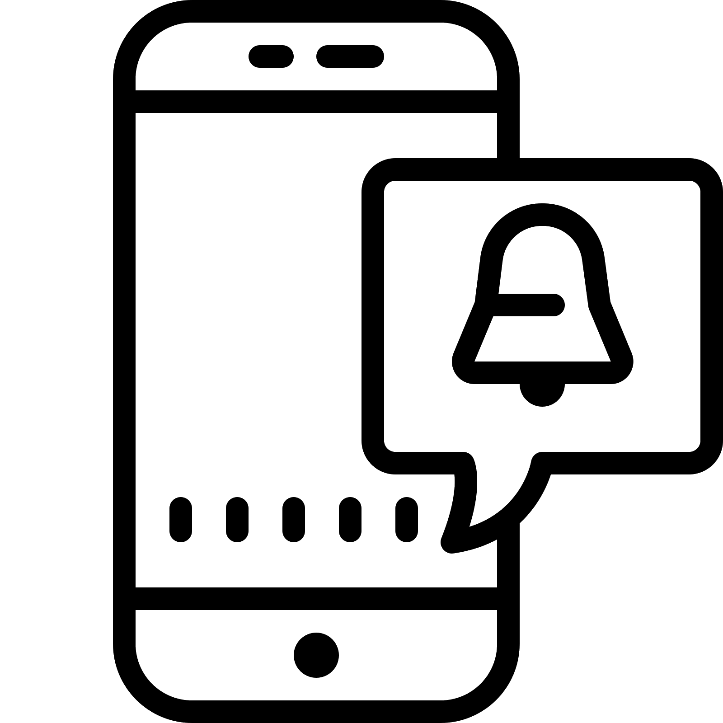
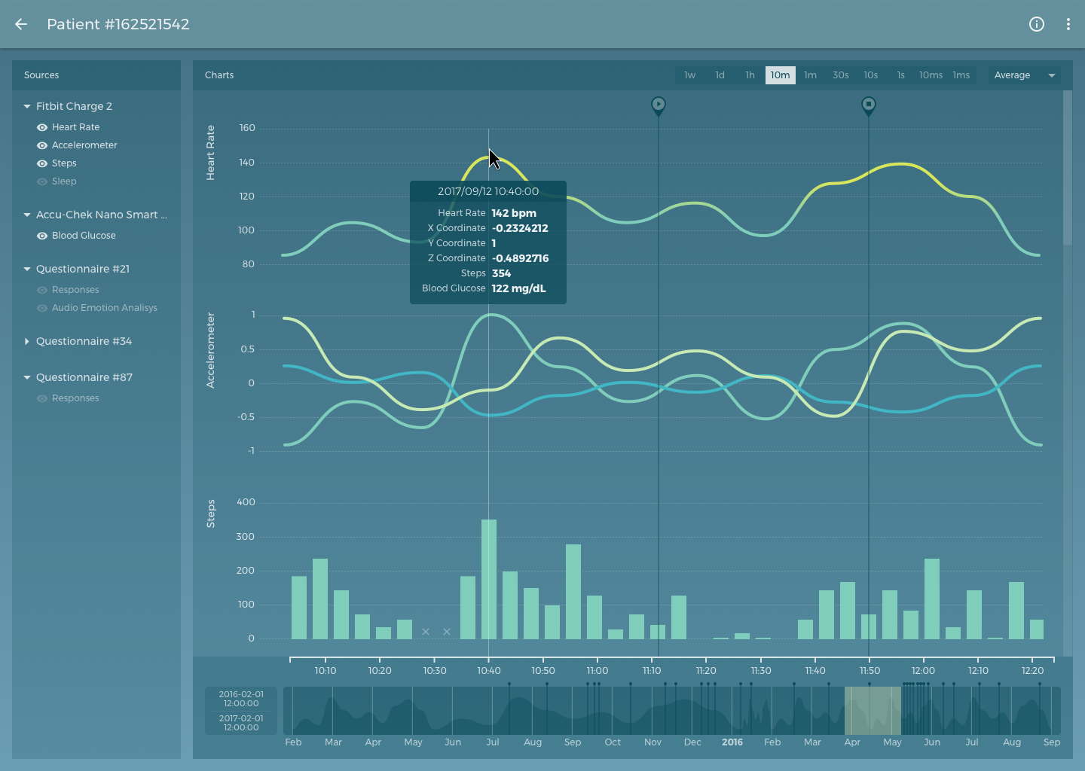
Passive Data
Active Data
IoT sensors
Third Party RESTful API connection
Personalised Self Report & Interventions
e.g. Third Party App Integration
RADAR-IoT Framework
Passive App
Participant Management
Historical Data Storage & Analytics
Interventions Visualisation
Real Time Data Analytics
👉 https://radar-base.org/
Notes:
RADAR-base is an interacting systems of components, broadly broken down into three main parts:
[click-list]
Firstly is passive monitoring. This refers to data collected in the background. Passive data comes from four main sources, these are:
The phone sensor data collected via the passive app, these include things like accelerometer, phone use, local Bluetooth device counts etc
The passive-app-integrated wearable devices, these devices connect directly to over Bluetooth to the passive app
Next there is 3rd Party RESTful API integrations, examples of this include collecting data from FitBit and Garmin devices from the device vendor
and lastly, we have IoT sensors, these are a diverse range of sensor types with a typically static deployment.
Next we have active monitoring, this is the other major data type. Here conscious effort is required by the participant in order to generate the data. These are collected through the active app, and include things like questionnaires and a variety tests and tasks. The active app is also highly configurable, it is relatively simple to add new questionnaires and tasks with configuration files. The facility for integrating other 3rd-party apps also exists in RADAR-base, and we'll see an example of this with the MassScience app used in the Covid Collab study. Active data is commonly used to provide some context or labelling to the passive streams of data.
Finally, we have the Backend Infrastructure, this is a set of microservices we have developed with Apache Kafka providing horizontal scalability at its heart. This includes [click-list] Study Management user interfaces, Data Storage, Real Time Data Analysis capacity, Intervention Feedback and finally Visualisation. Other 3rd-Party components such as REDCap can optionally be integrated to provide seamless electronic-Case-Register-Form capacity. [end-click-list]
To date RADAR-base has been used to collect data in a wide range of diseases some examples include: Depression, Epilepsy, Multiple Sclerosis, Heart Disease, COPD, ILD, etc. You can find out more about RADAR-base on the project website [click].

Slide 8
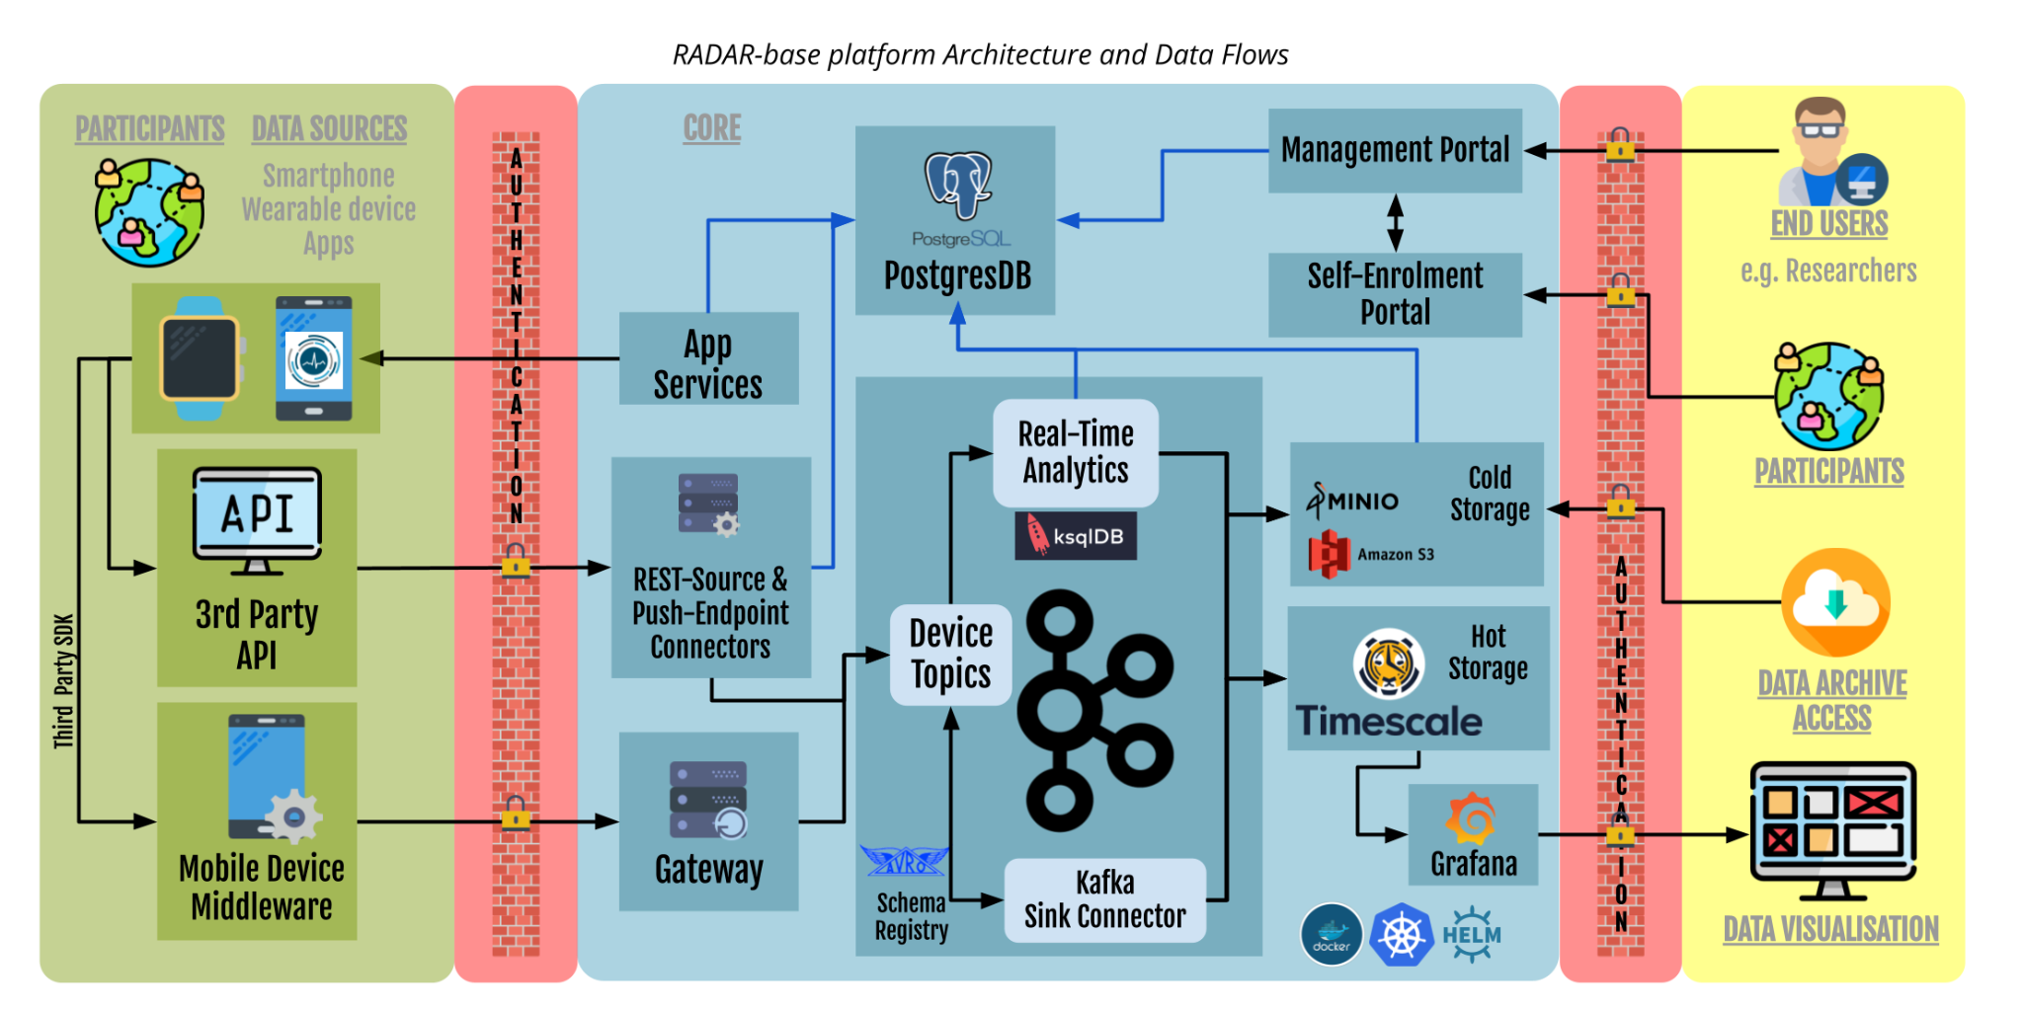
Notes:
The actual platform is a set of different interacting components, we can't get into the detail here but the key components are around using Apache Kafka for scalability and stream processing. This was definitely a interesting choice and a lot of the functionality for RADAR-base is predicated on this technology.

Slide 9
Where is RADAR-base being used?
Notes:
So, onto a brief background about RADAR-base, the remote monitoring platform we built to collect our data

Slide 10
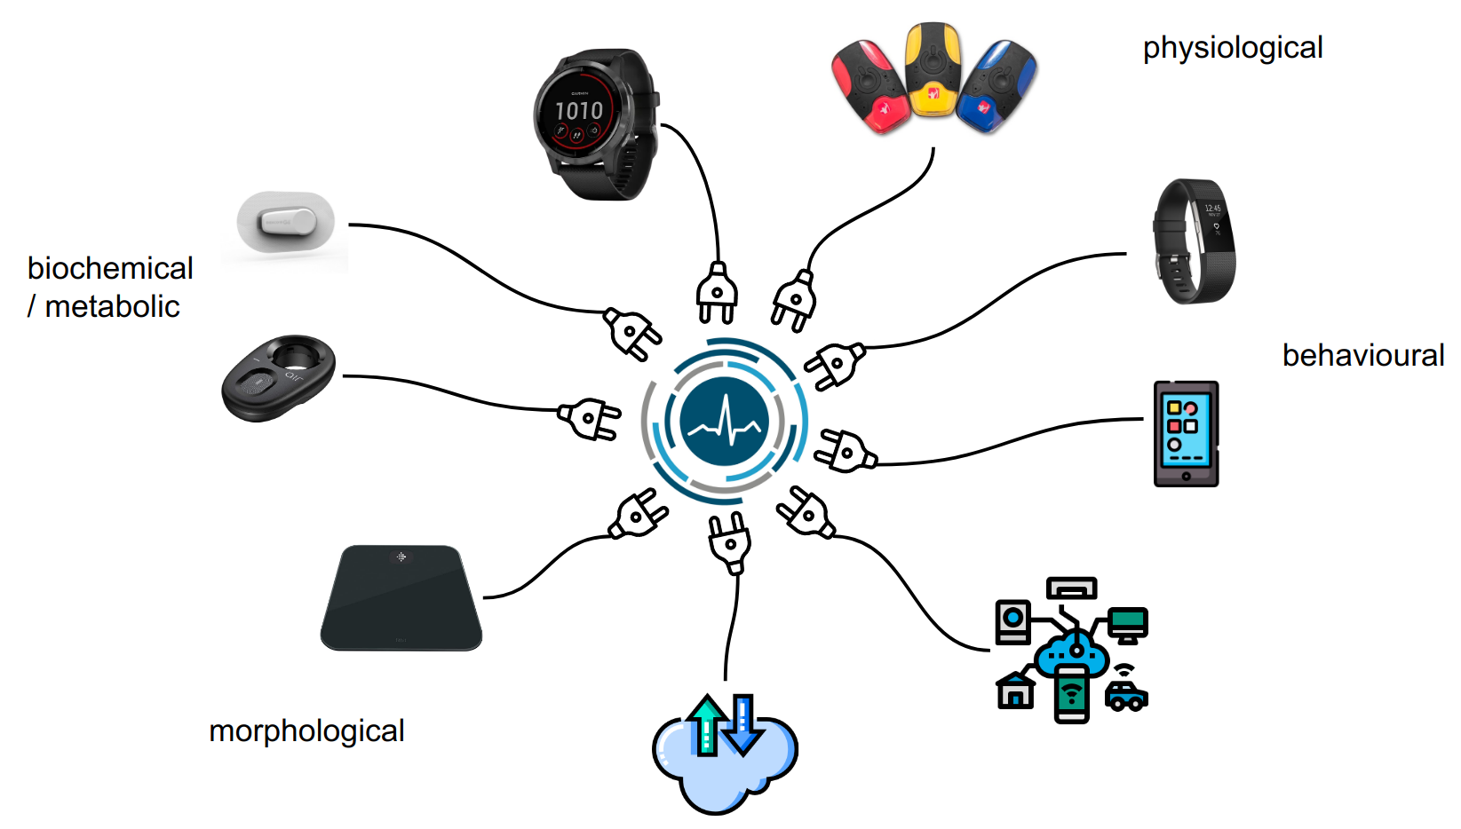

Research Use Cases
Citizen Science
Mobile Health
Basic Research
Remote Research
studies
e.g.
Covid Collab,
MOVE migrant study
e.g.
RADAR-CNS,
NSHD (1946 Birth Cohort),
RADAR-AD,
ART-CARMA,
EDIFY,
RATE-AF,
RALPMH
Decentralised Trials
e.g. CHDR:
RATE-AF
Pediatric Asthma,
Tonsillectomy trials.
Notes:
We broadly split things we do at the moment in three domains, Basic Research, Decentralised Trials and Citizen Science Studies.
Mobile health (mHealth) and decentralized clinical trials (DCTs) are both important developments in healthcare that are having a significant impact on patient outcomes and research scale and efficiency.
mHealth basic research involves the use of mobile devices and other digital technologies to collect data and provide healthcare services remotely. This can include things like telemedicine, health apps, and wearable devices that monitor vital signs and provide real-time feedback.
citizen science is the participation of the general public, typically self-enrolled, in generating data towards a common goal, the facility of the mobile health has greatly improved the capability cost and efficiency of running these types of studies at scale.
finally,
decentralised trials DCTs involve the use of technology to conduct clinical trials outside of traditional clinical settings, such as hospitals or research centers. This can include virtual visits, remote monitoring of study participants, and the use of digital tools to collect data. DCTs can offer many benefits, including greater convenience and flexibility for study participants, reduced costs and faster recruitment, and the ability to include a more diverse and representative study population.
Together, mHealth, DCTs and Citizen Science have the potential to transform the way healthcare is delivered and research is conducted by leveraging the power of technology to make healthcare more preemptive, accessible and efficient, we can improve patient outcomes and accelerate the development of new treatments and therapies.
Today's symposium should feature examples of all of these modalities. We have a really exciting schedule of presenters who will showcase the diversity of research being empowered by the RADAR-base platform.

Slide 11
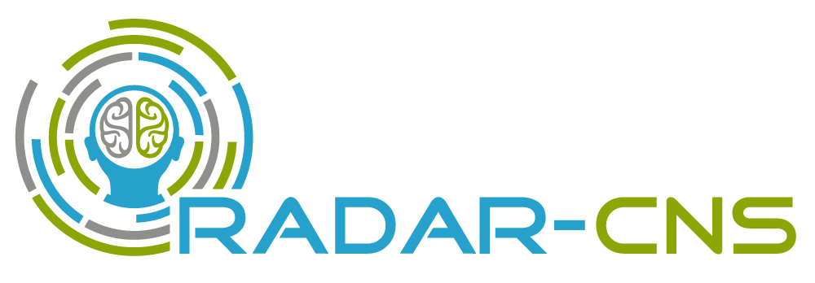
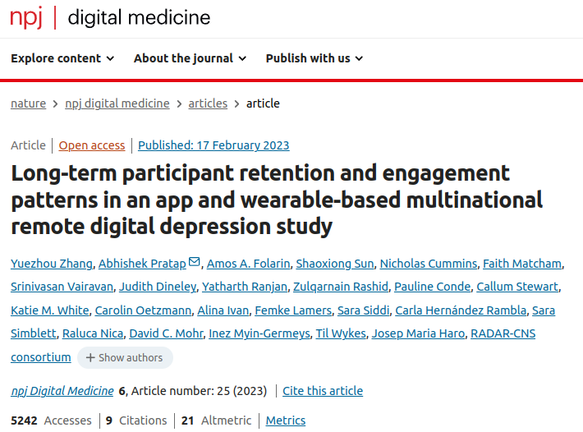
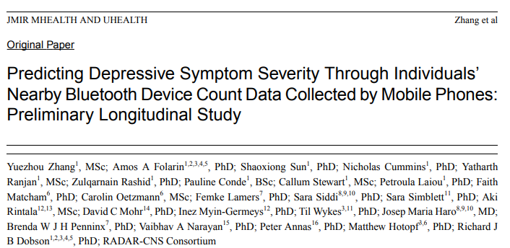
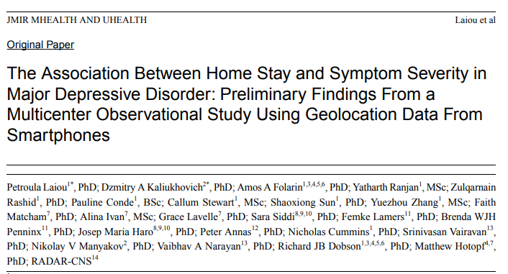
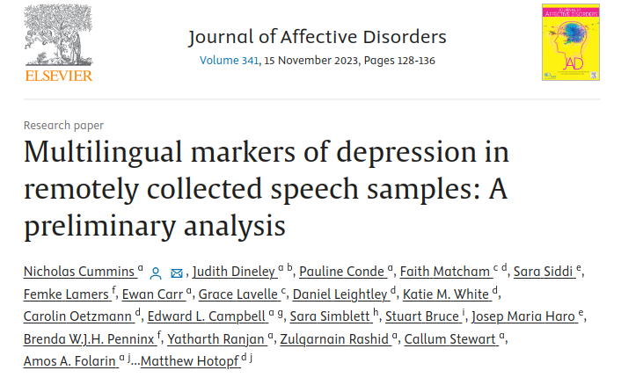
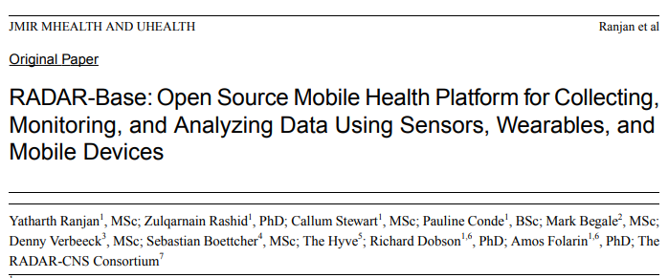
Development of RADAR-base started here
3 Disease Study
Epilepsy
Major Depression
Multiple Sclerosis
n=1500
Data Sources: Active App, Passive App, E4, Fitbit, Faros, Biovotion, (and others).
Notes:
This is an example of an exploratory "basic science" study
RADAR-CNS recruited approximately 1,500 participants into 3 mental health / neurological studies. Epilepsy, Depression and Multiple Sclerosis.
Here participants were directly recruited for these studies and provided devices, data was collected prospectively for the duration of the study.
In the example of the Depression study we collected data for the participant follow-up of 2-years

Slide 12
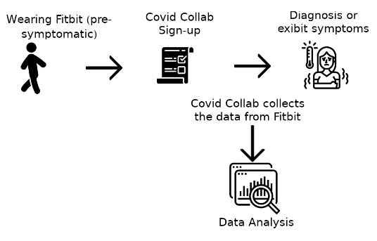
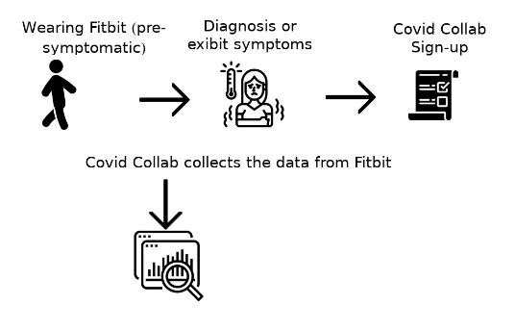
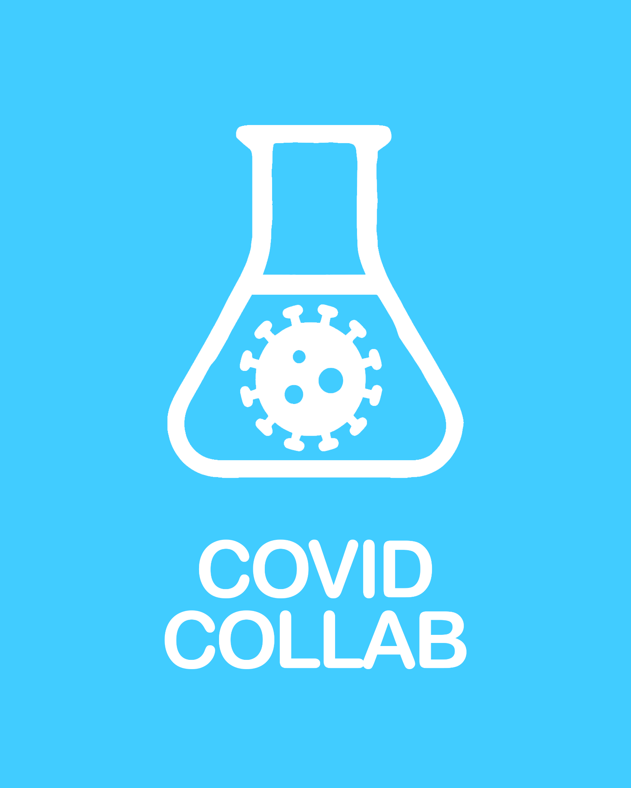
COVID-Collab: Wearables Citizen Science Project
Prospective Data
Participants sign up before they are infected with COVID-19
n=877 cases
https://covid-collab.org
Retrospective Data
Participants sign up after they are infected with COVID-19
Because historic data is available, if participants wore the device during illness then wearable data is still collectable.
n=1041* cases
*(n~500 of these are within a few days from diagnosis)
Total recruited
22k
Notes:
The Covid Collab study was an example of a "citizen science" study we ran during the pandemic.
This was performed in collaboration with Fitbit where the study was advertised to UK fitbit users
we could at low cost build a cohort of 22k participants (about half of which provided data from their Fitbits), participants were allowed to sign up both before or after covid infection.
because devices like FitBit provide historic data access, we could access multi-year pre-pandemic datasets which would form the baselines for our analyses.

Slide 13
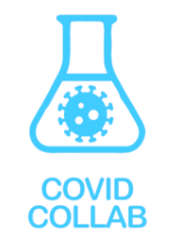






COVID-19 NPIs effects were clearly observable
Notes:
At the time, Long-Covid was largely syndromic.
The middle panel from this study, shows some of the interesting results we published on objective measures for evidence of Long Covid in patients (in addition to subjective symptom questionnaire reports).

Slide 14



RATE-AF (RADAR-base at the heart of a cardiology trial)
About RATE-AF
RATE-AF is funded through a National Institute for Health Research (NIHR) Career Development Fellowship to Dr Dipak Kotecha, Chief Investigator of the trial at the Institute of Cardiovascular Sciences, University of Birmingham.
Research areas
Cardiology - atrial fibrillation
User group
Elderly (average age ~ 65 years)
n=50 patients for follow-up (out of 160 patients in original trial)
typical recording period: 12 months
Data Sources:
active app, FitBit
Notes:
RATE-AF is a sub-study from the EU funded BigData@Heart project, here was to use remote monitoring for the outcome measure in this clinical trial testing Digoxin.

Slide 15






NSHD: 1946 Birth Cohort
1946
2024
Post-2nd World War UK Birth Cohort
Rich longitudinal historic dataset
Cohort Augmented mHealth component with RADAR-base
Target n=2000
Data Sources:
Active App, Passive App, Garmin Vivosmart 4
…
…
…
We are working with several other cohort studies to implement similar "bolt-on" mobile health study & linking participant-donated wearable and phone data to the wealth of historic longitudinal (e.g. surveys) and static data (e.g. genetic) in the cohort.
Notes:
Finally, an example of an existing cohort where in this case running since the end of the Second World War, here we added a remote monitoring component to this to monitor this elderly population with low-burden wearable devices to provide insight into quality of life, activity and various cardiology interests. The key advantage here is this data can augment the historic data collected already.

Slide 16
How can I use RADAR-base?
Notes:
So, onto a brief background about RADAR-base, the remote monitoring platform we built to collect our data

Slide 17


Self deploy open source RADAR-base
https://radar-base.org
Onsentia managed RADAR-base service and consultancy
https://onsentia.com
Notes:
Open source community is a repository of experience in running remote monitoring studies
Managed Service & advisory consultancy and help study design, protocol, device integration, ethics, consent, information governance and finally help collect data on Onsentia's platform.

Slide 18
Thank You
&
Questions
Notes:
So, onto a brief background about RADAR-base, the remote monitoring platform we built to collect our data

